Slide 1
Secure Data Hiding In Images Using Steganography
CAPSTONE PROJECT
Presented By: Kishan Kumar Jha
Student Name: Kishan Kumar Jha
College Name: Haldia Institute of Technology
Department : CSE(Cyber Security)

Slide 2
OUTLINE
Problem Statement
Technology used
Wow factor
End users
Result
Conclusion
Git-hub Link
Future scope

Slide 3
Problem Statement
Traditional encryption methods are not secure and are easily detectable.
Need for a secure way to hide confidential messages within images.
Ensuring data security while maintaining the integrity of the cover image.

Slide 4
Technology used
Programming Language: Python
Image Processing Library: OpenCV
File Handling & Security: Basic encryption logic for password protection
Platform: Windows 11(os), Laptop
Code Editor: Idle shell 3.13.2

Slide 5
Wow factors
Uses steganography to embed a message into an image without any noticeable changes made to the image.
Python language is used for giving the logic of encryption and decryption.
Works on any standard image file format (Jpg format is uploaded in github).

Slide 6
End users
Law Enforcement Agencies – For tracking illegal content or securing sensitive evidence.
Corporate Organizations – To secure internal communication and confidential data.
Government & Defense – Secure message transmission without raising suspicion.
Researchers & Academicians – For studying data security techniques and cryptography.
Software Developers – Learning steganography concepts and their applications.

Slide 7
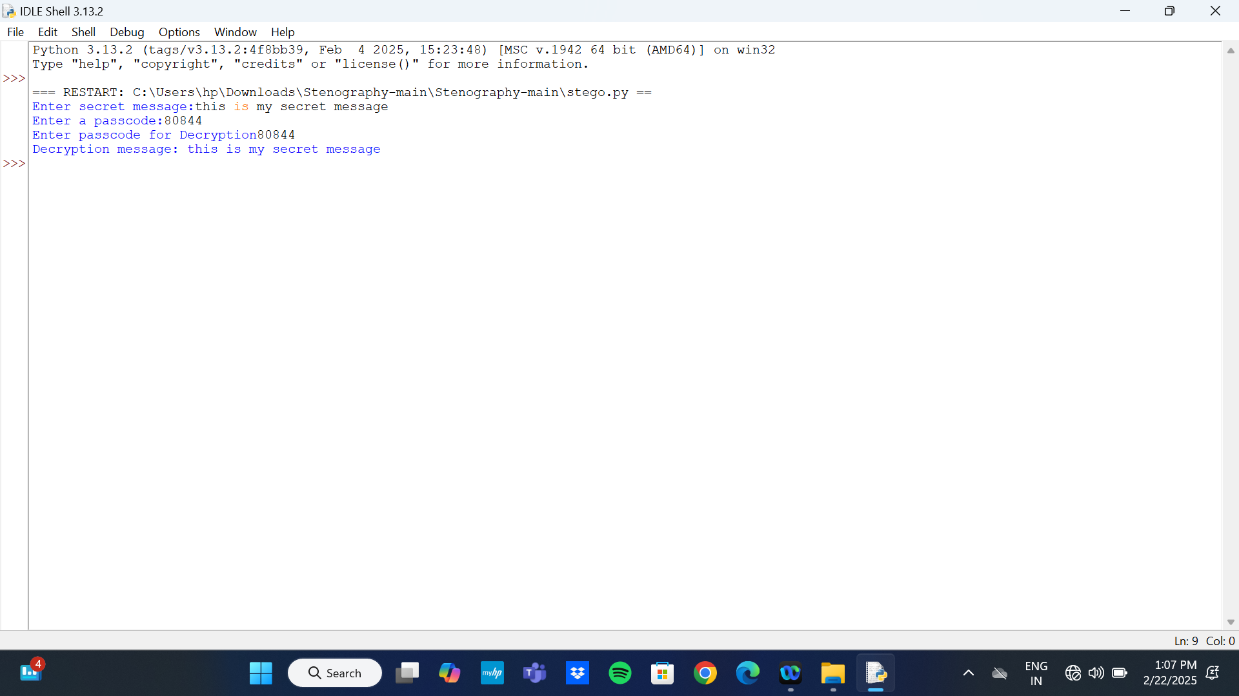
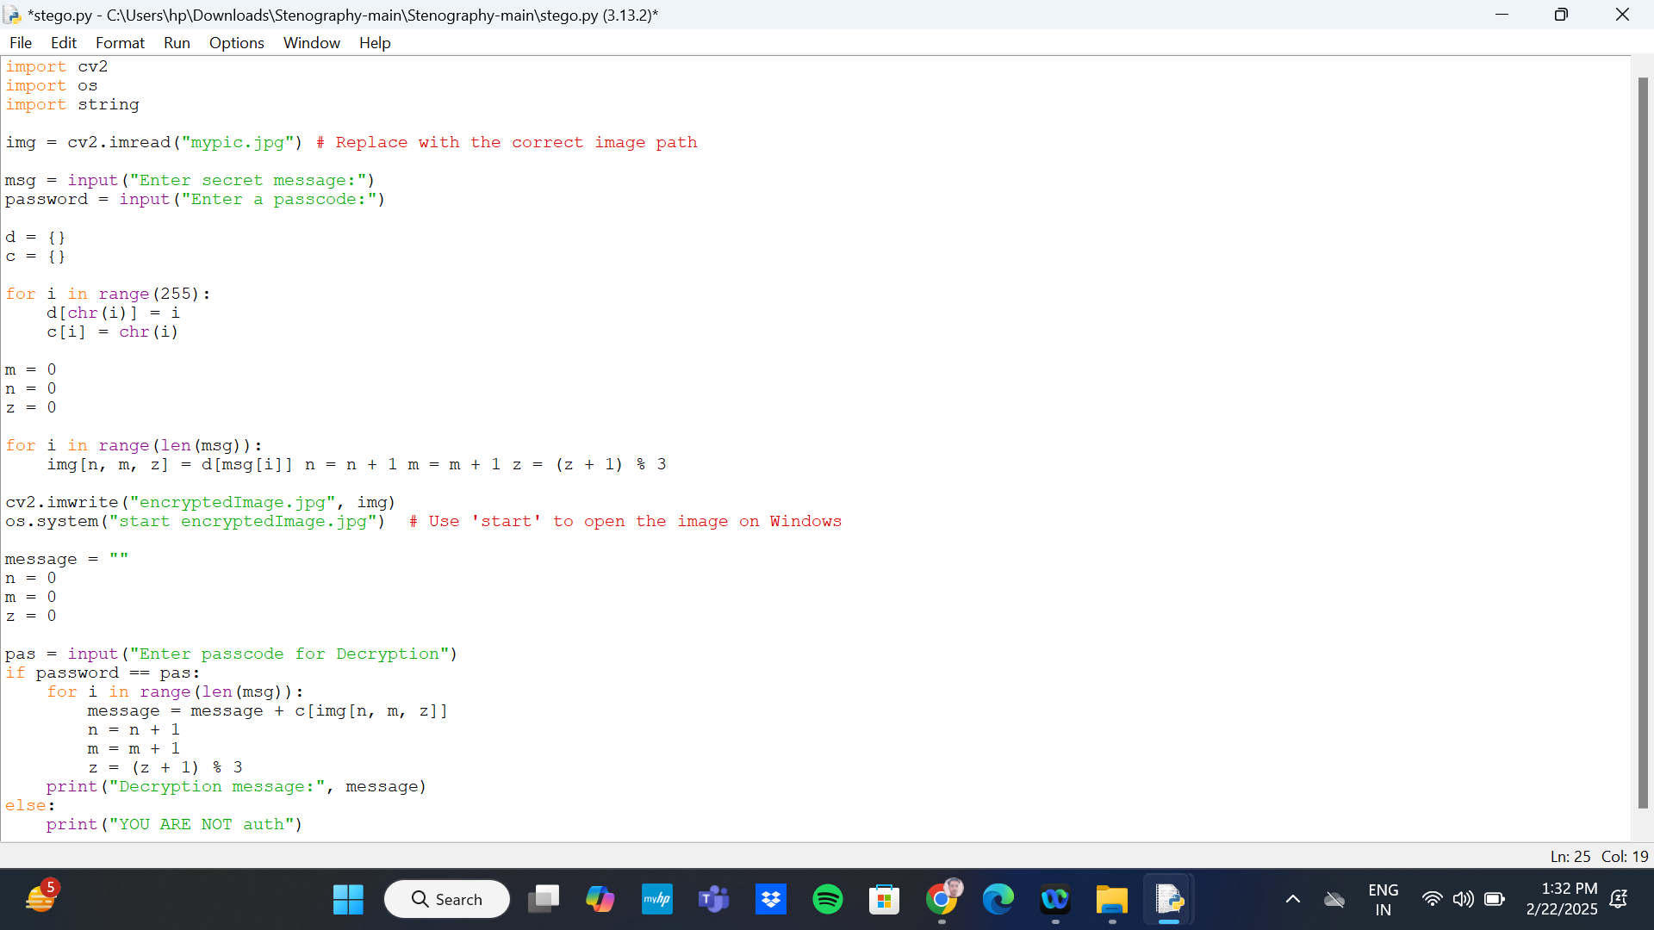
Results
Output Compiled Filed:
Source Code:

Slide 8


RESULTS
Orignial image:
Encrypted Image:

Slide 9
Conclusion
Steganography provides a easy and secure way of communicating sensitive information.
This project showcases a simple yet effective implementation of message hiding in images.
Possible Future improvements can make the project more robust, secure, and scalable.

Slide 10
GitHub Link
https://github.com/Kishan-14/StegoAicteProject.git

Slide 11
Future scope
Enhanced Encryption Methods – Utilize AES encryption before concealing text within images.
Expansion to Audio & Video – Extend steganography techniques beyond just images.
AI-Resistant Techniques – Develop strategies to evade detection by advanced forensic tools.
Cross-Platform Availability – Make steganography accessible via mobile apps and web platforms

Slide 12
THANK YOU

